Slide 1


Domino Tilings of the Chessboard
An Introduction to Sampling
and Counting
Dana Randall
Schools of
Computer Science
and Mathematics
Georgia Tech

Slide 2
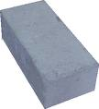

Building short walls
How many ways are there to
build a 2 x n wall with 1 x 2 bricks?
1
2
2
n

Slide 3
Building short walls
How many ways are there to
build a 2 x n wall with 1 x 2 bricks?
1
2
2
n

Slide 4
Building short walls
n=0 :
n=1 :
n=2 :
n=3 :
n=4 :

Slide 5
Building short walls
n=0 :
n=1 :
n=2 :
n=3 :
n=4 :
The number of walls equal:
f_{n} = 1, 1, 2, 3, 5

Slide 6

Building short walls
n=0 :
n=1 :
n=2 :
n=3 :
?
n=4 :
The number of walls equal:
f_{n} = 1, 1, 2, 3, 5, 8, 13, 21, . . .

Slide 7
Building short walls
n=0 :
n=1 :
n=2 :
?
n=3 :
n=4 :
The number of walls equals:
f_{n} = 1, 1, 2, 3, 5, 8, 13, 21, . . .
{
n
2
f_{n} =
2

Slide 8
Building short walls
n=0 :
n=1 :
n=2 :
?
n=3 :
n=4 :
The number of walls equals:
f_{n} = 1, 1, 2, 3, 5, 8, 13, 21, . . .
{
n
2
f_{n} =
2

Slide 9
Building short walls
n=0 :
n=1 :
n=2 :
?
n=3 :
n=4 :
The number of walls equals:
f_{n} = 1, 1, 2, 3, 5, 8, 13, 21, . . .
{
n
f_{n-1}
2
f_{n} =
f_{n-2}
2

Slide 10

The Fibonacci Numbers
The number of walls equals:
f_{n} = 1, 1, 2, 3, 5, 8, 13, 21, . . .
{
f_{n-1}
f_{n} =
f_{n-2}
f_{n} = f_{n-1} + f_{n-2} , f₀ = f₁ = 1
f_{n} = (φ^{n} + (1-φ)^{n}) /√5 ,
where: (“golden
ratio”)
φ = ^{1+√5}
2

Slide 11
Domino Tilings
Given a region R on the infinite chessboard,
cover with non-overlapping 2 x 1 dominos.
Where is a tiling? Do any even exist?
How many tilings are there?
What does a typical tiling look like?
When do we stop our algorithms?
Why do we care?

Slide 12
Where is a tiling? Do any exist?
n
★ Only if n is even!
n

Slide 13
Where is a tiling? Do any exist?
The Area of R must be even
n
n

Slide 14

Where is a tiling? Do any exist?
The Area of R must be even
n
★ There must be an equal number
of black and white squares.
n

Slide 15

Where is a tiling? Do any exist?
The Area of R must be even
With an equal number of white
and black squares
Is this enough?

Slide 16
Where is a tiling? Do any exist?
The Area of R must be even
With an equal number of white
and black squares
. . .
Is this enough?
?
There is an efficient algorithm to decide if R is
tileable and to find one if it is. [Thurston]

Slide 17
Domino Tilings
Where is a tiling? Do any even exist?
How many tilings are there?
What does a typical tiling look like?
When do we stop our algorithms?
Why do we care?

Slide 18
How many tilings are there?
Short 2 x n
walls
≈ φ^{n}

Slide 19
How many tilings are there?
Short 2 x n
walls
≈ φ^{n}
n
Aztec
Diamonds
= 2^{n(n+1)/2}
[Elkies, Kuperberg,
Larson, Propp]
n=0 n=1 n=2 n=3
# = 1 2 8 64

Slide 20
How many tilings are there?
Short 2 x n
walls
≈ φ^{n}
n
Aztec
Diamonds
= 2^{n(n+1)/2}

Slide 21
How many tilings are there?
Short 2 x n
walls
≈ φ^{n}
n
Aztec
Diamonds
= 2^{n(n+1)/2}
Square n x n
walls
?

Slide 22
How many tilings are there?
Square n x n walls
<
2 ^{(Area/4)} < #
<
# < 4 ^{(Area)}

Slide 23
How many tilings are there?
Short 2 x n
walls
#≈ φ^{n}
Aztec
Diamonds
#=2^{n(n+1)/2}
Square n x n
walls
2^{Area/4} < # < 4^{Area}

Slide 24
How many: An Algorithm
Mark alternating vertical
edges;

Slide 25
How many: An Algorithm
Mark alternating vertical
edges;
Use marked tiles;
Markings must line up!

Slide 26
How many: An Algorithm
s₁
t₁
s₂
t₂
s₃
t₃

Slide 27
How many: An Algorithm
s₁
t₁
s₁
t₁
s₂
t₂
s₂
t₂
s₃
t₃
s₃
t₃
We want to count
non-intersecting sets of
paths from s_{i} to t_{i .}
[R.]

Slide 28
How many: An Algorithm
We want to count
non-intersecting sets of
paths from s_{i} to t_{i .}
s₁
t₁
s₂
t₂
s₃
t₃
Let a_{ij} be the number of paths from s_{i} to t_{j} .

Slide 29
How many: An Algorithm
1 4 16
1 3 12 52
1 5 24
1 7 40
1 9
1 10
We want to count
non-intersecting sets of
paths from s_{i} to t_{i .}
s₁
t₁
s₂
t₂
s₃
t₃
Let a_{ij} be the number of paths from s_{i} to t_{j} .
40 10

Slide 30
How many: An Algorithm
1 8
1 7 40
1 5 25
0 3 13 62
1 5 24
1 6 30
We want to count
non-intersecting sets of
paths from s_{i} to t_{i .}
s₁
t₁
s₂
t₂
s₃
t₃
Let a_{ij} be the number of paths from s_{i} to t_{j} .
40 10
40 62 30

Slide 31
How many: An Algorithm
1
1 10
1 8
1 6 30
1 4 16
0 2 6 22
We want to count
non-intersecting sets of
paths from s_{i} to t_{i .}
s₁
t₁
s₂
t₂
s₃
t₃
Let a_{ij} be the number of paths from s_{i} to t_{j} .
40 10
62 30
10 30 22

Slide 32
How many: An Algorithm
[Gessel, Viennot]
We want to count
non-intersecting sets of
paths from s_{i} to t_{i .}
s₁
t₁
s₂
t₂
s₃
t₃
Let a_{ij} be the number of paths from s_{i} to t_{j} .
40 10
62 30
10 30 22
Det
= 1728.
This is the number domino tilings!!

Slide 33
Proof sketch for two paths:
a₁₁ x a₂₂ counts what we want + extra stuff.
= #
a₁₂ x a₂₁ also counts the extra stuff.
Therefore (a₁₁ x a₂₂) - (a₁₂ x a₂₁) counts real tilings.
(This is the 2 x 2 determinant!)

Slide 34
Domino Tilings
Where is a tiling? Do any even exist?
How many tilings are there?
What does a typical tiling look like?
When do we stop our algorithms?
Why do we care?

Slide 35
Why Mathematicians Care
The Aztec Diamond
Arctic Circle Theorem
[Jockush, Propp, Shor]

Slide 36
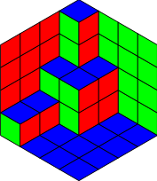

Lozenge tilings on the hexagonal lattice

Slide 37
Lozenge tilings on the hexagonal lattice
Matchings on the dual
(triangular) lattice

Slide 38
Why Mathematicians Care
Lozenge tilings on the hexagonal lattice

Slide 39
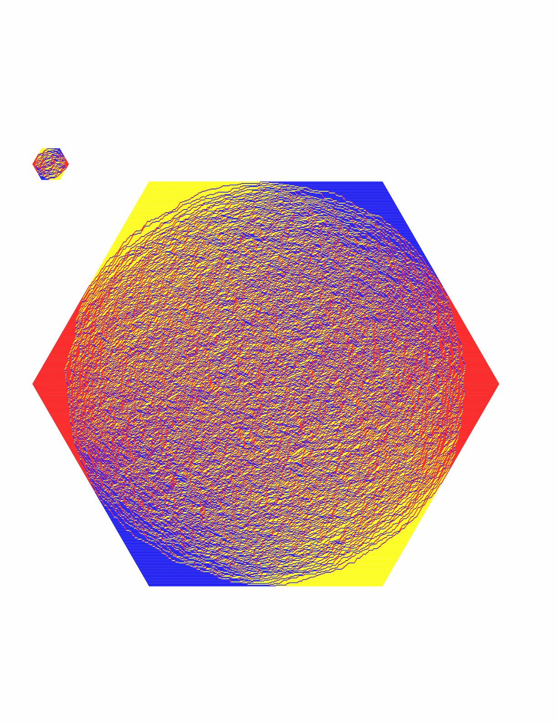
Why Mathematicians Care

Slide 40
Why do we care?
Mathematics: Discover patterns
Chemistry, Biology: Estimate probabilities
Physics: Count and calculate other functions
to study a physical system
Nanotechnology: Model growth processes

Slide 41
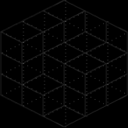
Why Physicists Care
“Dimer models”: diatomic molecules adhering
to the surface of a crystal.
The count (“partition function”) determines:
specific heat, entropy, free energy, …
What does “nature” compute?

Slide 42
Domino Tilings
Where is a tiling? Do any even exist?
How many tilings are there?
What does a typical tiling look like?
When do we stop our algorithms?
Why do we care?

Slide 43


What does a typical tiling look like?

Slide 44

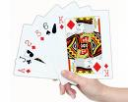
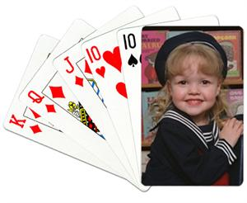
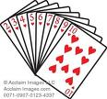

What does a typical tiling look like?
“Mix” them up!

Slide 45
Markov chain for Lozenge Tilings
v
v
Repeat:
Pick v in the lattice region;
Add / remove the ``cube’’ .
at v w.p. ½, if possible.

Slide 46
Markov chain for Lozenge Tilings
v
v
The state space is connected.
If we do this long enough, each tiling will be
equally likely.
3. How long is “long enough” ?

Slide 47
Domino Tilings
Where is a tiling? Do any even exist?
How many tilings are there?
What does a typical tiling look like?
When do we stop our algorithms?
Why do we care?

Slide 48


When do we stop our algorithms?
v
v
3. How long is “long enough” ?
Thm: The lozenge Markov chain is “rapidly mixing.”
[Luby, R., Sinclair]
☒
☑
2^{n}, 3^{n} n²,
10^{√n}, …
^{(exponential)}
n², n log n,
n¹⁰, …
^{(polynomial)}

Slide 49
What about other models?
Dimer model
Potts model
Hardcore model
Domino tilings k-colorings Independent sets

Slide 50
What about other models?
Pick a 2 x 2 square;
Dimer model
Potts model
Hardcore model
Domino tilings k-colorings Independent sets

Slide 51
What about other models?
Pick a 2 x 2 square;
Rotate, if possible;
Dimer model
Potts model
Hardcore model
Domino tilings k-colorings Independent sets

Slide 52
What about other models?
Pick a 2 x 2 square;
Rotate, if possible;
Otherwise do nothing.
Dimer model
Potts model
Hardcore model
Domino tilings k-colorings Independent sets

Slide 53
What about other models?
Pick a vtx and a color;
Dimer model
Potts model
Hardcore model
Domino tilings k-colorings Independent sets

Slide 54
What about other models?
Pick a vtx and a color;
Recolor, if possible;
Dimer model
Potts model
Hardcore model
Domino tilings k-colorings Independent sets

Slide 55
What about other models?
Pick a vtx and a color;
Recolor, if possible;
Otherwise do nothing.
Dimer model
Potts model
Hardcore model
Domino tilings k-colorings Independent sets

Slide 56
What about other models?
Pick a vtx v and a bit b;
Dimer model
Potts model
Hardcore model
Domino tilings k-colorings Independent sets

Slide 57
What about other models?
Pick a vtx v and a bit b;
If b=1, try to add v
Dimer model
Potts model
Hardcore model
Domino tilings k-colorings Independent sets

Slide 58
What about other models?
Pick a vtx v and a bit b;
If b=1, try to add v;
If b=0, try to remove v;
O.w. do nothing.
Dimer model
Potts model
Hardcore model
Domino tilings k-colorings Independent sets

Slide 59
What about other models?
Thm: All of these chains are rapidly mixing.
Dimer model
Potts model
Hardcore model
Domino tilings k-colorings Independent sets

Slide 60
HOWEVER . . .
Three-colorings:
The local chain is fast for 3-colorings in 2-d [LRS]
but slow for 3-colorings in sufficiently high dimension.
[Galvin, Kahn, R, Sorkin], [Galvin, R]
Independent Sets
The local chain is fast for sparse Ind Sets in 2-d
[Luby, Vigoda],…, [Weitz]
but slow for dense Ind Sets. [R.]

Slide 61
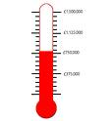



Weighted Independent Sets
Sparse
Dense
Fast Phase Transition Slow

Slide 62
Why?
“Even”
“Odd”
n²/2
(n²/2-n/2)
n²/2
λ
λ
λ
#R/#B

Slide 63
Summary
Where
How
What
When
Why

Slide 64

Summary
Algebra
Where
Combinatorics
How
Algorithms
What
When
Why

Slide 65
Summary
Algebra
Where
Combinatorics
How
Algorithms
What
Geometry
When
Probability
Why
Physics

Slide 66

Summary
Algebra
Where
Combinatorics
How
Algorithms
What
Geometry
When
Probability
Why
Physics
Chemistry
Nanotechnology
Biology

Slide 67

Math
THANK YOU !

Slide 68
Math
+ CS
THANK YOU !

Slide 69
Math
+ CS
THANK YOU !
+
Biology,
Chemistry,

Slide 70
Math
+ CS
THANK YOU !
+
Biology,
Chemistry,
+
Physics,
Nanotechnology,
. . .

Slide 71
THANK YOU !

